Slide 1

Institute of road and transport technology, erode
Stock management system
Project Guide: Dr. K. G. MAHESWARI, M.Tech., Ph.D.
submitted by
Chandru S 731118205004
Medhun Raja S R 731118205016

Slide 2
INTRODUCTION
The project stock management system is a complete desktop based application designed on PHP technology using xampp software.
The main aim of the project is to develop stock management system model software in which all the information regarding the stock of the organization will be presented.
It is an intranet based desktop application which has admin component to manage the stock and maintenance of the stock system.There is a provision of insertion , updating and deletion of the stock also.
Here the login page is created in order to protect the management of the stock of organization in order to prevent it from the threads and misuse of the stock.

Slide 3
PROBLEM STATEMENT
Based on my survey, I have found that there are institute that still using paper based or filing system or Excel sheet to save their information or details about their stocks
After Analyzing many existing Stock Management Database we have now the obvious vision of the project to be developed. Before we started to build the application- our team had many challenges. We defined our problem statement as:
To make desktop based application of database for small organization.
To make the system easily managed and can be secured.
To cover all the area in the database like purchase detail, product detail and stock management.

Slide 4
REQUIREMENTS
Software Requirements:
Xampp SQL Server 2012
PHP and MYSQL Codes
Windows 7 and Above.
Hareware Requirements:
Intel core i3
4 GB RAM
2 GB Hardware Capacity.

Slide 5
Why php ?
PHP is a server side scripting language that is embedded in HTML. It is used to manage dynamic content, databases, session tracking, even build entire e-commerce sites.
You add, delete, modify elements within your database through PHP. Access cookies variables and set cookies.
Using PHP, you can restrict users to access some pages of your website.It can encrypt data.
PHP is
Simplicity
Efficiency
Security
Flexibility
Familiarity.

Slide 6
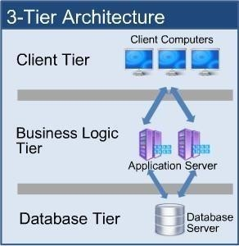
3-Tier architecture
Client Tier:
The main function of this tier is to display information to the user upon user’s request generated by user’s inputs such as firing button events.
Business Tier:
The middle tier, business logic, is called by the client to make database queries. It provides core function of the system as well as connectivity to the data tier
Data Tier:
Data layer is also the class which gets the data from the business tier and sends it to the database or gets the data from the database and sends it to business tier.

Slide 7
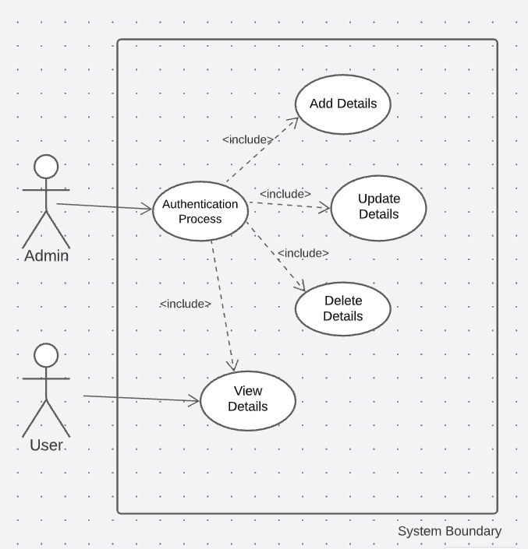
Usecase diagram

Slide 8
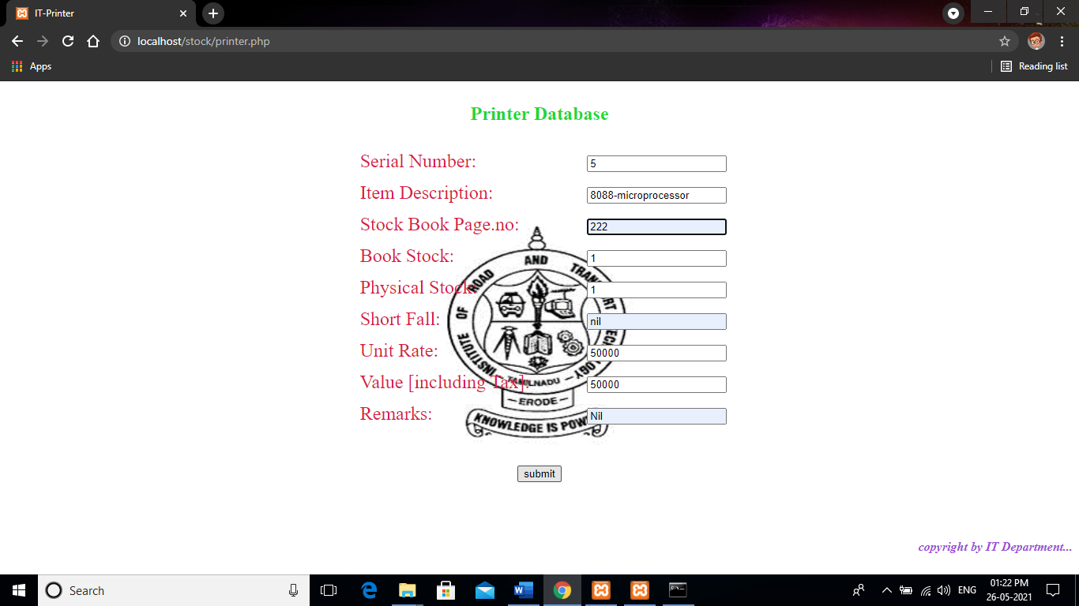
Insertion
In Insertion, we are inserting the data of the stocks into the
database only by admin.
Query:
$query = "INSERT INTO printer(";
$query.="number,item_text,stock_book,book_stock,
physical_stock,short_fall, unit_rate, value_rate ,
remarks)";
$query.= "VALUES(";
$query.="'{$number}','{$item_text}','{$stock_book}’,
'{$book_stock}’,'{$physical_stock}','{$short_fall}’,
'{$unit_rate}','{$value_rate}’, '{$remarks}' ";
$query.= ")";

Slide 9
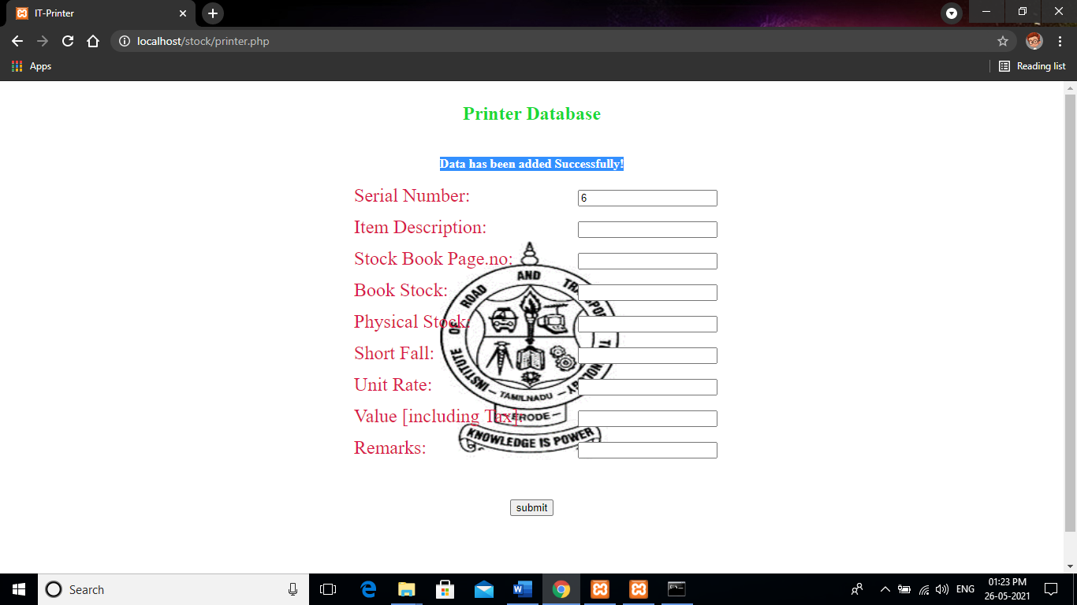
Insertion done…
$insert_row = mysqli_query($conn,$query);
if($insert_row){
$message = "Data has been added Successfully!";
}
else{
die("Query for printer is not executed");
}
}
the Serial Number is automatically update- to avoid the collapse of data.

Slide 10
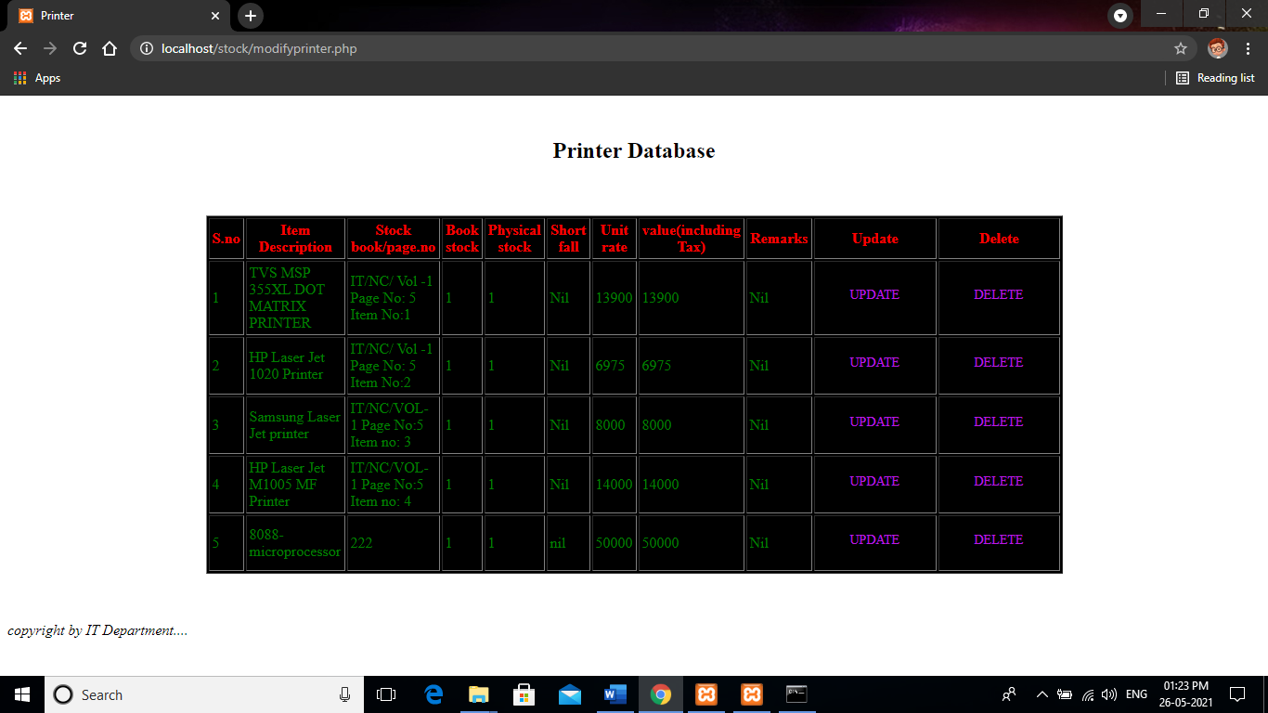
Updation and deletion
The important operation in both updation and deletion process is to get the correct the serial number which is selected by admin for the updation and deletion process.
The serial number which is the important attribute based on its value the data in the database is either update (or) delete.

Slide 11
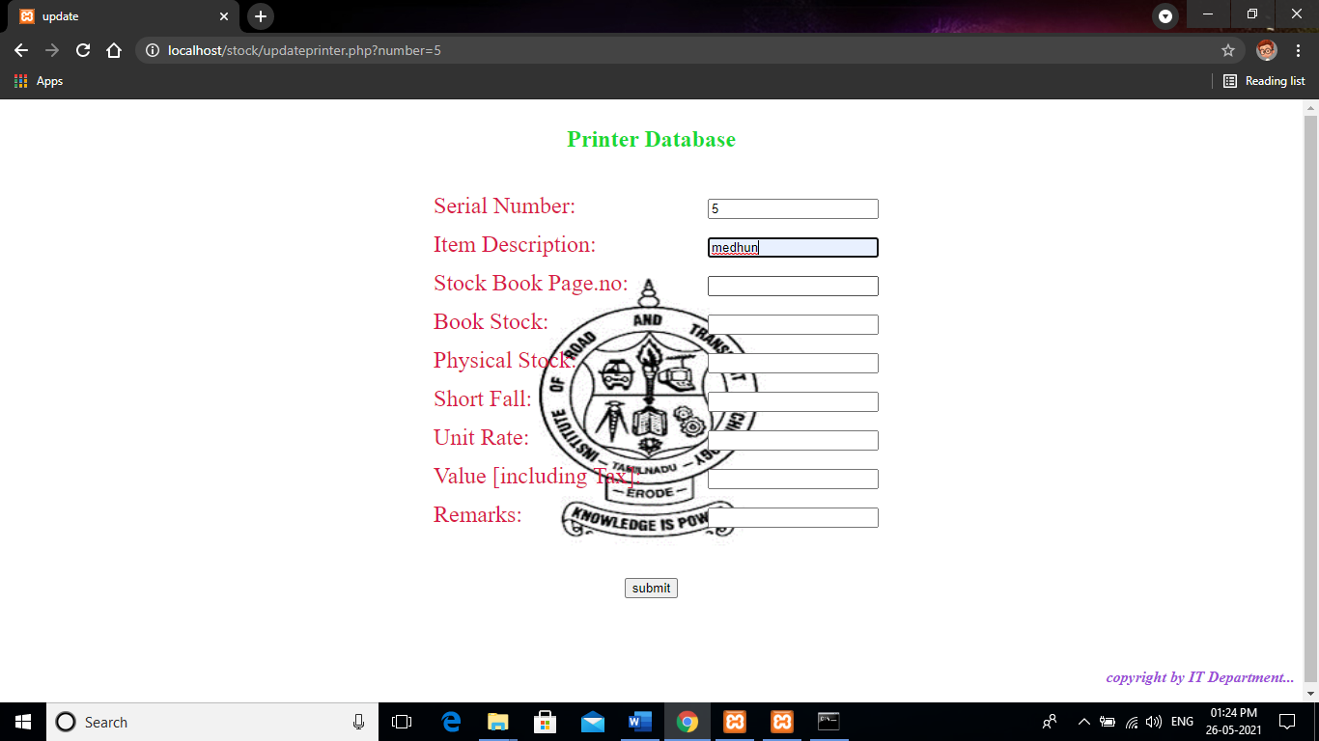
updation
//modify.php
//update button in the table
<form>
//these is used to get the serial number which is selected by the admin
<a href="updateprinter.php?number=<?php echo $number; ?>“class="s1“
onclick="return confirm ('Are you want to delete...?');">UPDATE</a>
</form>
Query:
$query="UPDATE printer SET item_text='{$item_text}’,stock_book=‘{$stock_book}’,
book_stock='{$book_stock}',physical_stock='{$physical_stock}’,
short_fall='{$short_fall}',unit_rate='{$unit_rate}’,value_rate='{$value_rate}’,
remarks='{$remarks}' WHERE number=$number";

Slide 12
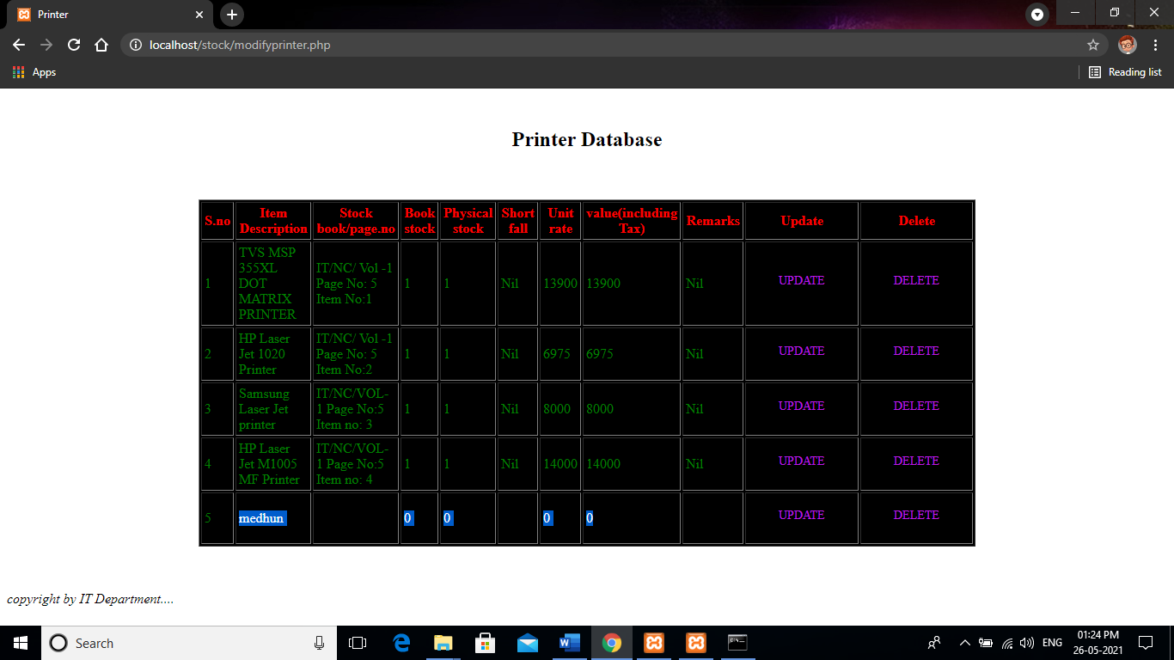
Updation done…
$insert_row = mysqli_query($conn,$query);
if($insert_row){
$message = "Data has been updated Successfully!";
header("location: modifyprinter.php");
}
else{
die("Query for update is not executed");
}
}
After Update it redirect to this location –”modifyprinter,php”
and able to see the updation.

Slide 13
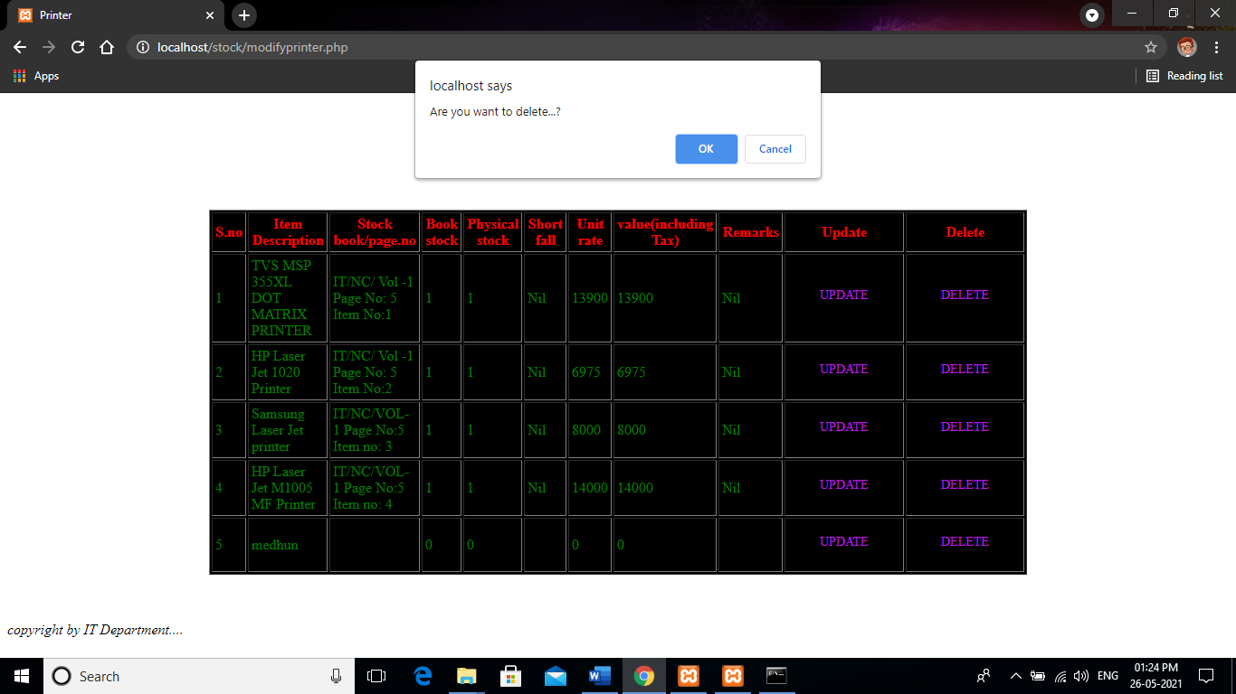
deletion
//modify.php
//delete button in the table
<form>
//these is used to get the serial number which is selected by the admin
<a href="deleteprinter.php?number=<?php echo $number;
?>" class="s1" onclick="return confirm ('Are you want to
delete...?');">DELETE</a>
</form>
Alert message – confirmation by admin.

Slide 14
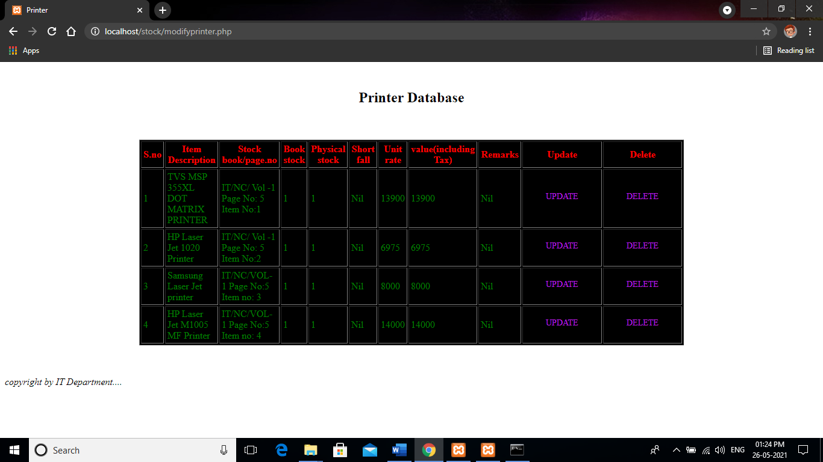
Deletion done…
//delete.php
$number = $_GET['number'];
$query = "DELETE FROM printer WHERE number=$number";
$result = mysqli_query($conn,$query);
if($result==true) {
header("location: modifyprinter.php");
}
else{
header("location: modifyprinter.php");
}
After delete it redirect to this location –”modifyprinter,php”
and able to see the deletion.

Slide 15
Screen shorts
Login Page
User
Page
Admin page
Modify page

Slide 16
conclusion
To conclude, Stock Management System is a simple desktop based application basically suitable for our institution.
In this application we can able to insert, update and delete the item as per the requirement.
This application also provides a simple report on daily basis to know the items, product and stock details.
Through it has some limitations, our team strongly believes that the implementation of this system will surely benefit our institution.
Manual system are quite tedious ,time consuming ,less efficient and less accurate in comparison to the computerized system.

Slide 17

# stay home stay safe.

